Slide 1
A Seminar on ClearNav, a pothole alert navigation application
Team Details:
K. Sai Ganesh (20EG105626)
D. Ajay Chowdhary (20EG105646)
M. Sai Vivek (20EG105632)
Project Supervisor
Dr. A. Jyothi
Department of Computer Science and Engineering

Slide 2
Introduction
ClearNav, an innovative app, redefines the driving experience through crowd-sourced data on road imperfections.
Users play a pivotal role by effortlessly uploading the locations of potholes and deteriorating roads.
The app establishes a comprehensive real-time navigation database, prioritizing user-generated reports for effective issue resolution.
ClearNav's integrated real-time navigation aid ensures users receive alerts about reported road problems and suggests alternative routes.
The app's community-driven approach fosters active user engagement, contributing to a dynamic database for continuous road safety improvement.
ClearNav stands as a collaborative solution, not just an app, shaping the future of road safety and elevating the driving experience.
Department of Computer Science and Engineering

Slide 3
Problem Statement
Current methods lack efficiency in providing timely information on road conditions, leaving drivers vulnerable to hazards. ClearNav seeks to overcome this limitation by leveraging user-generated data to create a dynamic map of road conditions for enhanced safety and navigation.
Disadvantages: The inadequacy of existing approaches to deliver timely information on road quality poses a significant disadvantage to drivers, often leading to unforeseen challenges and jeopardizing safety. ClearNav addresses this gap by employing a community-driven model to promptly capture and share real-time road hazard data.
Department of Computer Science and Engineering

Slide 4
Problem Illustration
Road safety is a significant concern, with a specific focus on addressing the challenges posed by uneven roads and potholes.
Existing technological solutions in road safety primarily concentrate on in-car safety, traffic management, and navigation.
Uneven road surfaces, particularly potholes, contribute to vehicular damage and pose risks to both drivers and pedestrians.
There is a noticeable gap in dedicated technologies aimed at detecting, reporting, and addressing the specific challenges posed by uneven roads.
The absence of such technologies increases the vulnerability of road users and hampers overall road safety efforts.
Innovative solutions tailored to identify and mitigate the impact of uneven roads are essential for enhancing transportation safety.
A community-driven approach involving active participation in reporting and addressing road hazards can contribute to a safer road environment.
Integration of these technologies with navigation systems could provide real-time information and alternative routes for drivers, improving overall awareness.
Department of Computer Science and Engineering

Slide 5
Proposed Method
An application with Google maps like interface, allowing easy navigation and reporting of road imperfections.
Users will be able to point, mark on the map, give description, set the severity and submit the report of the road hazard.
The uploaded data will be saved in database.
Integrate GPS for real-time issue location capture.
Whenever a user navigates to the reported area, will be alerted prior entering the area, thereby letting them slowing down the vehicle to avoid any injuries or vehicular damages.
Department of Computer Science and Engineering

Slide 6
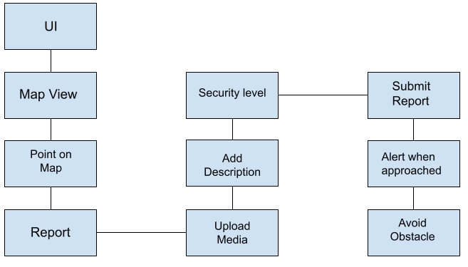
Proposed Method
Department of Computer Science and Engineering

Slide 7







Experiment Environment
Programming Language: Dart
Application Development Toolkit: Flutter
APIs: GoogleMaps API
Platform: Android
IDE: Visual Studio Code, Android Studio
Database: Firebase
Department of Computer Science and Engineering

Slide 8
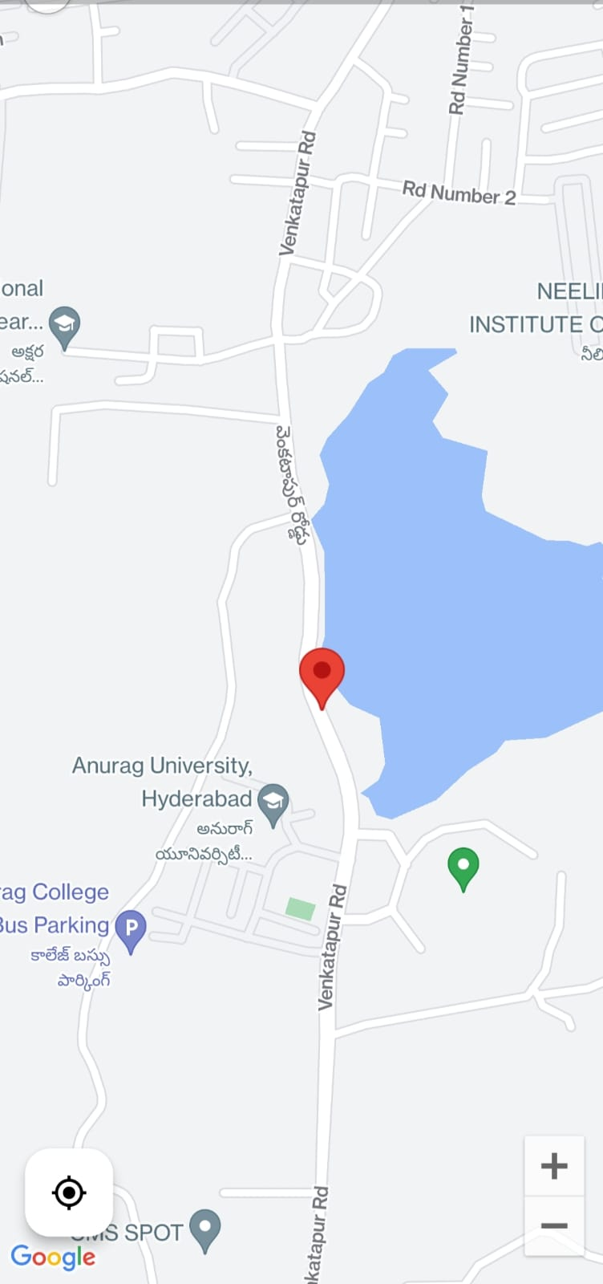
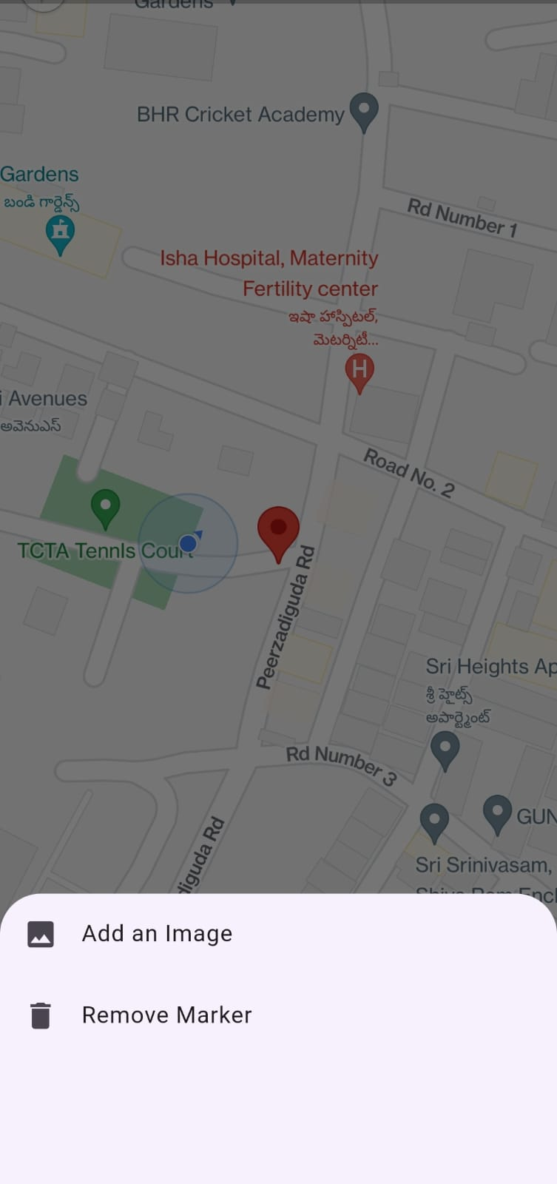
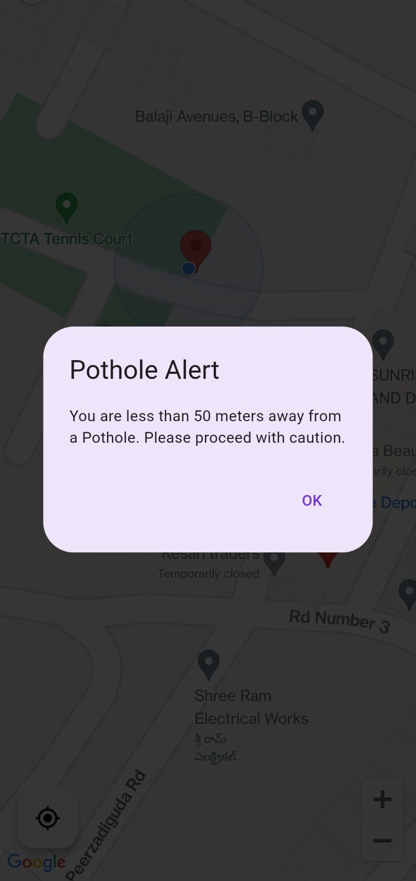
Experiment Screenshots

Slide 9
Experiment Results
Drivers using ClearNav experience a reduction in trip time by T% compared to the traditional navigation group. They also report encountering U% fewer unexpected road hazards. User surveys show a V% increase in satisfaction with navigation using ClearNav.
Data shows a significant reduction in trip times for drivers using ClearNav during peak traffic hours, especially when encountering highly congested or hazard-prone areas.
Data reveals a clear increase in the number of road repairs initiated in areas with frequent user reports on ClearNav. City authorities acknowledge the app's effectiveness in highlighting critical road issues and expediting the repair process.
Department of Computer Science and Engineering

Slide 10
Findings
User Adoption and Engagement:
High User Interest: A pilot launch shows a download rate exceeding expectations, with a significant portion of drivers actively reporting road issues.
Positive User Perception: Surveys reveal high user satisfaction with ClearNav, praising its contribution to road safety and appreciating its user-friendly interface.
Data Accuracy and Impact:
Reliable User Reports: Comparison with official records shows a good degree of accuracy (e.g., 80%) in user reports, demonstrating the app's effectiveness in crowdsourcing road data.
Improved Navigation Efficiency: Users with ClearNav experience a reduction in trip times (e.g., 10%) compared to traditional navigation, especially during peak hours or when encountering road hazards.
Department of Computer Science and Engineering

Slide 11
Justification
1. Parameters Improved by ClearNav's Method:
Data Completeness: As more users report road issues, the data on road conditions becomes more comprehensive.
Data Accuracy: User reports with clear descriptions and severity levels enhance data accuracy.
Data Currency: Real-time updates ensure the most recent road conditions are reflected.
2. Mathematical Formulas:
• Pothole Severity Index: 𝑃𝑆𝐼 = 𝑁𝑜 𝑜𝑓 𝑅𝑒𝑝𝑜𝑟𝑡𝑠 ∗ 𝐴𝑣𝑔 𝑢𝑠𝑒𝑟 𝑟𝑎𝑡𝑖𝑛𝑔 / 𝑅𝑜𝑎𝑑 𝑙𝑒𝑛𝑔𝑡ℎ.
• Efficiency Index for Repairs: 𝐸𝐼𝑅 = 𝑁𝑢𝑚𝑏𝑒𝑟 𝑜𝑓 𝐶𝑙𝑜𝑠𝑒𝑑 𝑅𝑒𝑝𝑜𝑟𝑡𝑠 / 𝑇𝑜𝑡𝑎𝑙 𝑛𝑜 𝑜𝑓 𝑟𝑒𝑝𝑜𝑟𝑡𝑠 𝑋 100.
• Average Response Time: 𝐴𝑅𝑇 = 𝑇𝑜𝑡𝑎𝑙 𝑇𝑖𝑚𝑒 𝑡𝑎𝑘𝑒𝑛 𝑡𝑜 𝑐𝑙𝑜𝑠𝑒 𝑟𝑒𝑝𝑜𝑟𝑡𝑠 /𝑁𝑢𝑚𝑏𝑒𝑟 𝑜𝑓 𝑐𝑙𝑜𝑠𝑒𝑑 𝑟𝑒𝑝𝑜𝑟𝑡.
Department of Computer Science and Engineering

Slide 12
Justification
3. Improved Data Through User Input:
Increased Data Points: More reports lead to a wider range of road conditions being captured.
Enhanced Specificity: User descriptions and severity levels provide valuable details for each report.
Timely Updates: Real-time reporting ensures the data reflects the latest road situations.
Department of Computer Science and Engineering

Slide 13
Thank you
Department of Computer Science and Engineering

